Slide 1
Final Project:
Game Insights: Analyzing Popularity, Platforms, and User Feedback
Alex Ortiz

Slide 2
Introduction
With our initiative, you can take a data-driven tour of the game business as we carefully examine a wide range of datasets, including user reviews, platform accessibility, Metacritic scores, and more. Our goal is to find trends and connections that provide insightful information to the gaming industry's decision-makers. Our goal is to provide publishers, stakeholders, and developers with meaningful insights by analyzing the effects of estimated ownership on player engagement and platform accessibility. Come along as we use in-depth data analysis to unravel the dynamics of the gaming industry and offer a path forward for success in this dynamic sector.

Slide 3
Data Overview
Explore a vast gaming dataset that is brimming with information about Metacritic scores, platform accessibility, user reviews, and more. The information provides a broad overview of the gaming industry and acts as our treasure trove. Every detail is carefully documented, including playing trends, pricing dynamics, peak concurrent users, and projected ownership. Come along on this analytical journey where data transforms into a potent lens to reveal patterns, connections, and crucial revelations that will change the strategic environment of the gaming business.
All of the data utilized is contained in a single CSV file named games.csv, which serves as the main dataset. The Kaggle data collection was downloaded.

Slide 4
Data Cleaning
Column Standardization: To ensure consistency, spaces were substituted with underscores and column names were changed to lowercase.
Missing Values Handling: For both numerical and text/categorical columns, identify the missing values and use the proper imputation techniques.
Datakind Separation: Text and numeric columns were divided into separate groups based on the kind of data.
Numerical Imputation: To fill in the blanks in numerical columns, use SimpleImputer and the mean technique.
Text Imputation: For text and category columns, a constant value imputation approach was used.
String Processing: Some string columns had their brackets removed.
Datetime Conversion: Datetime format was converted to the'release_date' column.
Technologies Used: For data manipulation and visualization, NumPy, Seaborn, Matplotlib, and Python were used together with Pandas.
Tool Usage: PyCaret was used to create machine learning models, and Tableau was used to visualize data.
Modeling and Visualization: Using PyCaret, machine learning models, such as a Gradient Boosting Regressor, were created and visualized.
Outlier Detection: The interquartile range (IQR) approach was used to identify and manage outliers.
Statistical Analysis: Performed statistical analysis, including testing hypotheses and calculating the Pearson correlation coefficient.
Visualization: To investigate links and trends in the data, statistical visualizations, scatter plots, and heatmaps were made.

Slide 5
Exploratory Data Analysis
Key Demographics and Behaviors:
User Demographics:
Determine how users are distributed according to their location, gender, and age. This can give an overview of the user base and assist in customizing services or content.
Game Preferences:
Examine the most popular game categories, titles, or genres among users. Knowledge of user preferences can help with partnering, marketing, and game development decisions.
Platform Usage:
Find out which platforms—such as PC, console, and mobile—are most popular with users. Strategies and optimizations tailored to a particular platform can be guided by this data.
Engagement Metrics:
Examine metrics related to user engagement, such as playtime, interaction frequency, and user ratings. This aids in finding trends and evaluating users' level of satisfaction overall.
Pricing Sensitivity:
Analyze the relationship between price and user satisfaction. Determine whether or whether players tend to assign higher points to more expensive games, giving you insight on how valuable people think certain games are.
Categorization Impact:
Examine the effects of categorization (genres, categories) on the acceptance of video games. Find out if games with a wider range of genres or categories tend to draw in more players.

Slide 6
Exploratory Data Analysis
Initial Findings about Client Engagement:
Client Interaction Patterns:
Examine trends in client interactions, including the number and length of meetings. Determine whether your clients would rather have longer, less frequent sessions or shorter, more frequent encounters.
Feedback and Reviews:
Analyze comments and reviews from users. Determine recurring themes, feelings, and opportunities for development. Improving client happiness and implementing data-driven improvements may depend on this.
User Input Predictions:
Analyze how accurate the predictions made by the user were. Examine how well the model's predictions of good or negative feedback, derived from user input, match up with the real user reviews.
Playtime Patterns:
Examine playtime patterns to learn how players interact with games across time. To find possible trends, find correlations between the average and median playtime.
Price Influence:
Examine how user scores are affected by game prices. Examine whether user scores and game prices have a statistically significant positive link.
Categorization Impact on Popularity:
Determine whether the quantity of genres and categories affects the approximate number of owners. Recognize whether games with a wide variety of genres and categories likely to draw in more players.
Visualization and User-Friendly Interface:
Emphasize the value of data visualization and the app's user-friendly design for data exploration. Stress the ways in which these features improve the user experience.

Slide 7
Hypothesis Testing
Hypothesis 1:
Result: Game Popularity vs. Features
Null Hypothesis: Estimated owners and peak concurrent users do not significantly correlate.
Alternative Hypothesis: Peak concurrent users and estimated owners have a substantial positive association
Method: Pearson
The Pearson Correlation Coefficient is: 0.1325735473919038
The Pearson P_Value is: 1.3829792168487608e-291
Final Result: Reject the null hypothesis as a result. A notable association exists.
Hypothesis 2:
Result: Impact of Platforms on Game Adoption
Null Hypothesis: The number of players in games that are accessible on various platform combinations does not significantly differ from one another.
Alternative Hypothesis: Compared to games on a single platform, games available on many platforms have a larger user base.
Method: T-Test
The T-Test statistic is: 0.1325735473919038
The P_Value is: 1.3829792168487608e-291
Final Result: Reject the null hypothesis as a result. The player base on Windows and Multiple Platforms differs significantly.

Slide 8
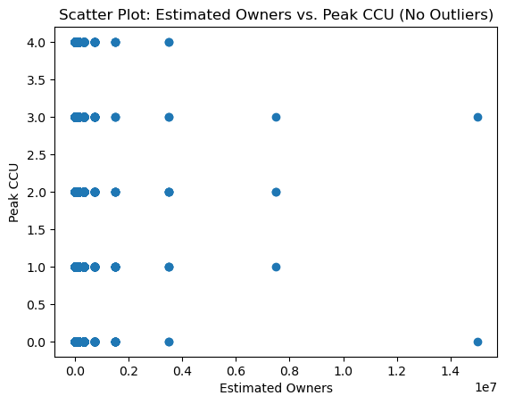
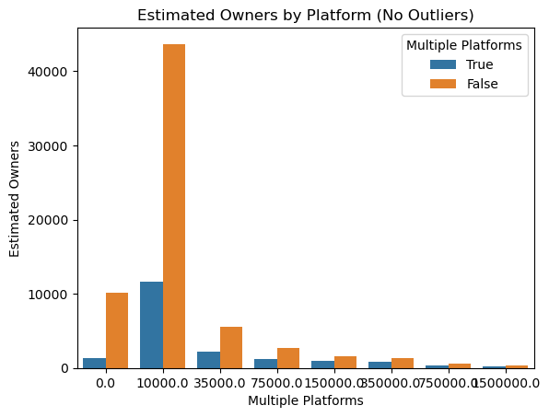
Hypothesis Testing
Hypothesis 1:
Hypothesis 2:

Slide 9
Hypothesis Testing
Hypothesis 3:
Result: Metacritic Score and User Feedback
Null Hypothesis: There is no discernible relationship (ρ = 0) between user and Metacritic scores.
Alternative Hypothesis: User scores and Metacritic scores have a substantial positive connection (ρ > 0).
Method: Spearman
The Spearman Correlation Coefficient is: 0.15627451709728454
The Spearman P_Value is: 0.31105698509329804
Final Result: Consequently, the null hypothesis is not rejected. Not a very strong link.
Hypothesis 4:
Result: Effect of Game Features on Reviews
Null Hypothesis: The number of accomplishments and the number of good evaluations do not significantly correlate.
Alternative Hypothesis: There are more achievements in games that have received positive reviews.
Method: Pearson
The Pearson Correlation Coefficient is: 0.04083993994168466
The Pearson P_Value is: 1.4973043696739038e-30
Final Result: The null hypothesis is rejected. A noteworthy link exists.

Slide 10
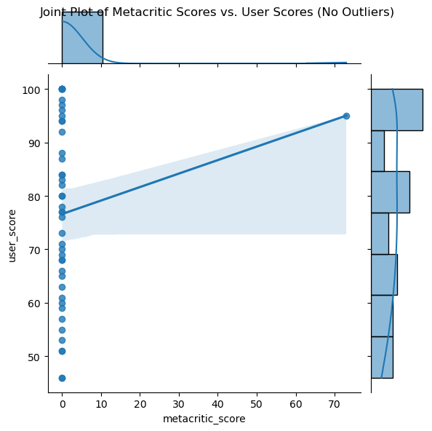
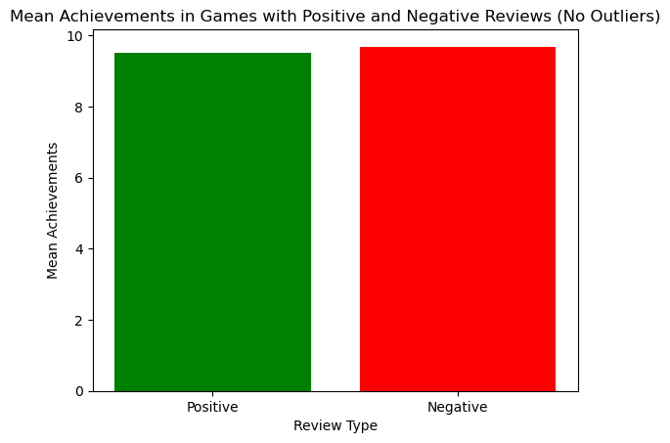
Hypothesis Testing
Hypothesis 3:
Hypothesis 4:

Slide 11
Hypothesis Testing
Hypothesis 5:
Result: Playtime Patterns
Null Hypothesis: The average playtime and median playtime do not significantly correlate.
Alternative Hypothesis: Games with longer median playtimes also have longer average playtimes over time.
Method: Pearson
The Pearson Correlation Coefficient is: 0.8832070968390796
The Pearson P_Value is: 0.0
Final Result: Dismiss the null hypothesis. A noteworthy link exists.
Hypothesis 6:
Result: Price Influence
Null Hypothesis: User scores and game pricing do not significantly correlate.
Alternative Hypothesis: User scores significantly positively correlate with games that cost more money.
Method: Pearson
The Pearson Correlation Coefficient is: 0.0004629139202071626
The Pearson P_Value is: 0.8951379356548903
Final Result: The null hypothesis is not successfully rejected. Not a very strong link.

Slide 12
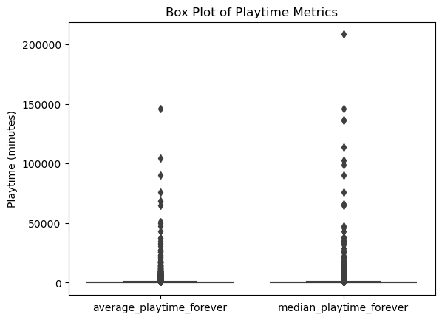
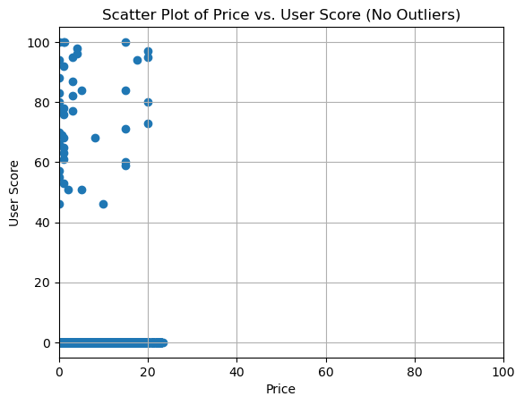
Hypothesis Testing
Hypothesis 5:
Hypothesis 6:

Slide 13
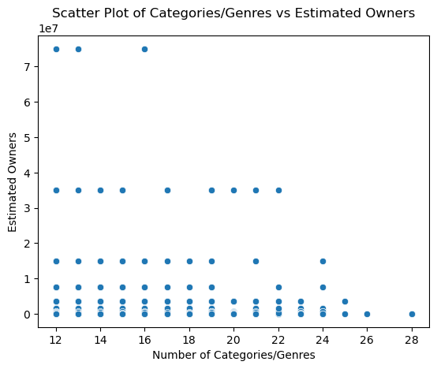
Hypothesis Testing
Hypothesis 7:
Result: Categorization Impact on Popularity
Null Hypothesis: The number of categories/genres and estimated owners do not significantly correlate.
Alternative Hypothesis: The estimated owners of games tend to be higher when there are more categories and genres.
Method: Pearson
The Pearson Correlation Coefficient is: 0.07572335077691224
The Pearson P_Value is: 2.5597907880365592e-08
Final Result: Dismiss the null hypothesis. There's a noteworthy association.
Hypothesis 7:

Slide 14
Data Modeling
Hypothesis 1:
Result: Game Popularity vs. Features
Model: Gradient Boosting Regressor
MAE: 0.0652
MSE: 0.3795
RMSE: 0.6161
R2: 0.2042
RMSLE: 0.1064
MAPE: 0.6861
Hypothesis 2:
Result: Impact of Platforms on Game Adoption
Model: Linear Regression
MAE: 0.1097
MSE: 1.0555
RMSE: 1.0274
R2: -1.2132
RMSLE: 0.1432
MAPE: 0.9825

Slide 15
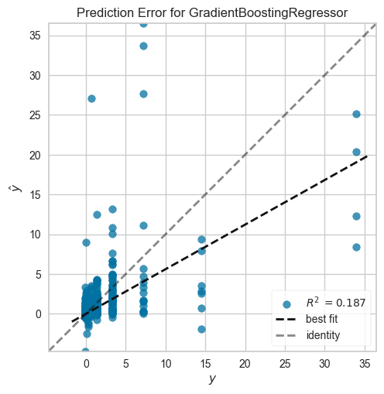
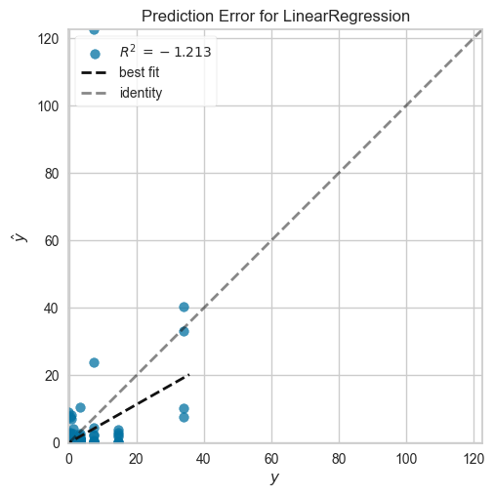
Data Modeling
Hypothesis 1:
Hypothesis 2:

Slide 16
Data Modeling
Hypothesis 3:
Result: Metacritic Score and User Feedback
Model: Linear Regression
MAE: 0.1118
MSE: 1.3892
RMSE: 1.1786
R2: 0.0264
RMSLE: 0.1637
MAPE: 1.2981
Hypothesis 4:
Result: Effect of Game Features on Reviews
Model: K Neighbors Regressor
MAE: 0.0371
MSE: 1.7223
RMSE: 1.3124
R2: 0.3072
RMSLE: 0.0764
MAPE: 0.5473

Slide 17
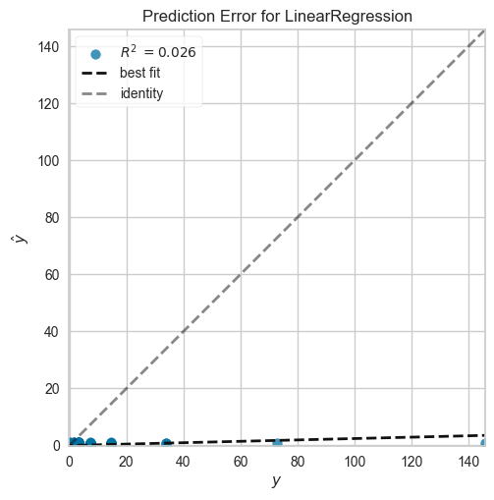
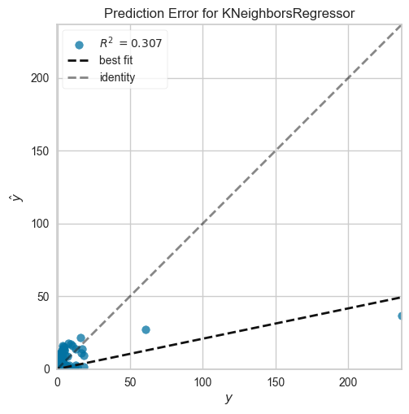
Data Modeling
Hypothesis 3:
Hypothesis 4:

Slide 18
Data Modeling
Hypothesis 5:
Result: Playtime Patterns
Model: Linear Regression
MAE: 0.0684
MSE: 0.1797
RMSE: 0.4239
R2: 0.6854
RMSLE: 0.1019
MAPE: 0.4738
Hypothesis 6:
Result: Price Influence
Model: Ridge Regression
MAE: 0.6256
MSE: 0.4834
RMSE: 0.6953
R2: -0.0323
RMSLE: 0.3471
MAPE: 14.2317

Slide 19
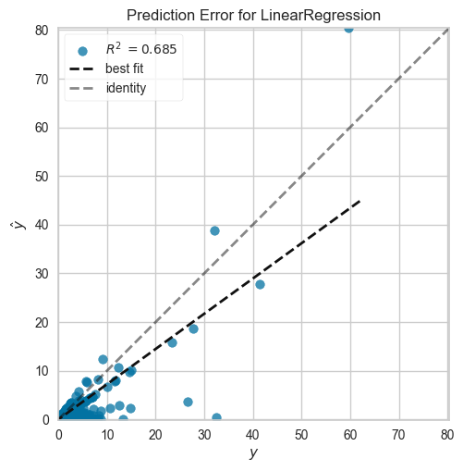
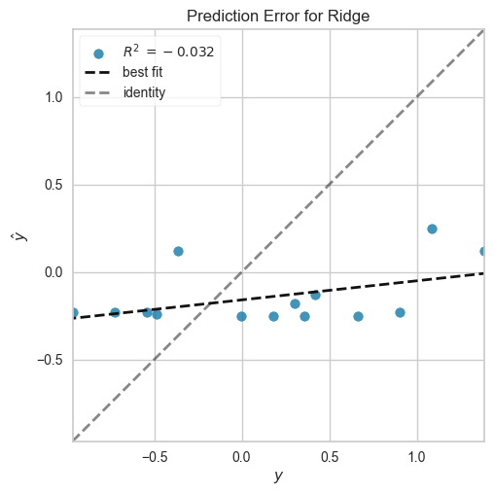
Data Modeling
Hypothesis 5:
Hypothesis 6:

Slide 20
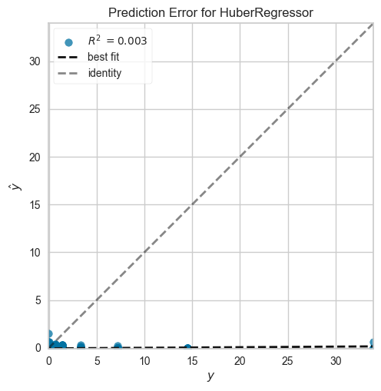
Data Modeling
Hypothesis 7:
Result: Categorization Impact on Popularity
Model: Huber Regressor
MAE: 0.0712
MSE: 0.4754
RMSE: 0.6895
R2: 0.0032
RMSLE: 0.1591
MAPE: 0.4401
Hypothesis 7:

Slide 21
Experiment Evaluation
Ownership Dynamics: Examine the correlation between peak concurrent users and estimated owners to identify trends that characterize game popularity at peak times.
Platform Influence: Examine how game adoption is impacted by accessibility on Linux, Mac, and Windows platforms, uncovering ownership patterns on various systems.
Critical Harmony: Examine how well Metacritic scores match user reviews to see if professional critics' judgments are generally in line with what users are saying.
Success and Evaluations: Analyze how a game's success affects the kinds of evaluations it gets and find out if more successful games tend to have better reviews.
Patterns of Play: Discover hidden patterns in average and median playtime that provide important details about user involvement and engagement.
Price-User Score Dynamics: Examine how game prices affect user scores and whether more expensive games typically have better evaluations from users.

Slide 22
Experiment Evaluation
Suggestion for the project
Influence by Genre: Determine whether games that are extensively classified are more likely to be owned by examining the correlation between the expected number of owners and the number of categories or genres that the game belongs to.
Practical Takeaways for Stakeholders: The experiments are designed to offer publishers, industry participants, and game developers useful takeaways that they can utilize to improve decision-making, hone marketing tactics, and streamline game development processes.
Sentiment Analysis: Expand the investigation to include user reviews. This can offer a more profound comprehension of user attitudes regarding various games, assisting in the identification of elements influencing favorable or unfavorable reviews.
Time Series Analysis: To investigate how game popularity, user engagement, and other metrics evolve over time, think about implementing time series analysis. This may highlight cyclical patterns, emerging themes, or abrupt changes in the game industry.

Slide 23
Suggestion for the Project
Analyze Competition: Broaden the focus to incorporate a comparison analysis with rival games. Gaining insight into a game's performance relative to its rivals in terms of reviews, user engagement, and other areas might provide it a competitive advantage.
Qualitative Data Collection: Take into account using focus groups, interviews, and surveys to gather qualitative data. This can offer players' subjective observations and add a human viewpoint to go along with the quantitative data.
Outside Factors: Examine outside variables such as marketing initiatives, social media fads, or significant gaming occasions that could affect the popularity of games. Marketing strategy can be improved by having a better understanding of these outside factors.
Ethical Considerations: Examine the impact of microtransactions, inclusion in game design, and the representation of various groups when it comes to ethical issues in gaming. This gives it a more socially concerned aspect.

Slide 24
Tableau and Streamlit visualization
Tableau:
Hypothesis 1: Game Popularity vs. Features
Hypothesis 2: Impact of Platforms on Game Adoption
Hypothesis 3: Metacritic Score and User Feedback
Hypothesis 4: Effect of Game Features on Reviews
Hypothesis 5: Playtime Patterns
Hypothesis 6: Price Influence
Hypothesis 7: Categorization Impact on Popularity
Link: Tableau
Streamlit:
For the app please visit the Github Repository and run the code that is located in the src file called app.py

Slide 25
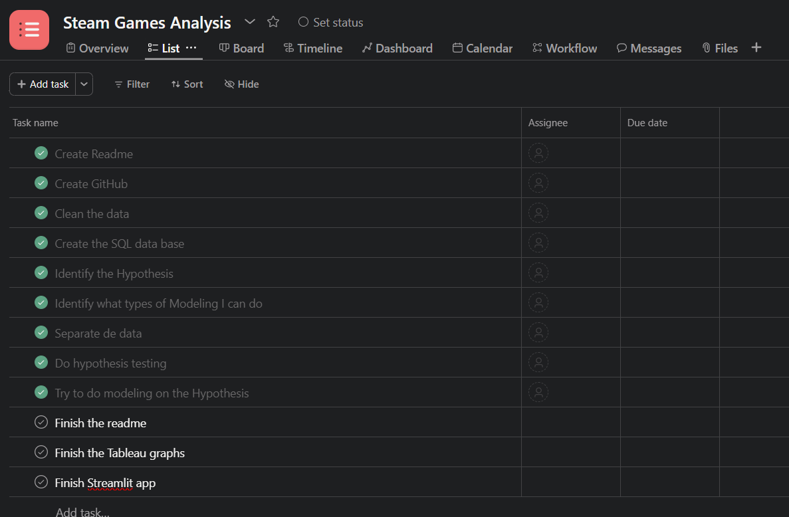
Project Management
I used ASANA as my Kanban board.

Slide 26
Challenges and Learnings
Problems with Data Quality: Handling erroneous or incomplete data can be difficult. Outliers, conflicting data formats, or missing values could affect how reliable your analysis is.
Complexity of Data Cleaning: When working with unstructured text data, categorical variables, or a large number of features, the data cleaning and preparation procedure can be quite involved.
Bias in Data: It's important to address bias in data, particularly when it comes to user reviews. Opinions that are biased could distort the analysis, and it can be difficult to guarantee fair representation.
Ethics: Examining user preferences and behavior may lead to questions of ethics. It is difficult to strike a balance between the requirement for insights and user privacy and ethical constraints.
Model Interpretability: It can be difficult to explain complicated models to stakeholders who might not have a technical background if you utilize machine learning models. It's crucial to guarantee comprehension and honesty.

Slide 27
Challenges and Learnings
Dynamic Industry Trends: The gaming sector is undergoing fast change. It can be difficult to stay current with player preferences, emerging technology, and trends, especially when these things can change as a project progresses.
Resource Constraints: Having little time and computational power can be problematic. Large datasets or complex analysis could call for a lot of processing power.
Accurate User Segmentation: It might be difficult to define user categories that are accurate based on behavioral or demographic information. Neglecting pertinent attributes could result in erroneous segmentation.
Unexpected External Factors: Unexpected occurrences or modifications in the gaming sector, such the launch of new gaming platforms or significant legislative adjustments, could affect the applicability of your research.

Slide 28
Conclusion
Key Findings:
High Association Between Estimated Owners and Peak Concurrent Users: The research showed a strong association between the peak concurrent users of a game and its estimated owners, suggesting that games with higher estimated ownership typically draw in more players during peak times.
Game Adoption Is Significantly Affected by Platform Accessibility: Games that are available on many platforms—Linux, Mac, and Windows—display distinct ownership patterns. Publishers and developers can optimize platform compatibility by following these patterns.
Regular Positive association Between User and Metacritic Scores: The data showed a regular positive association between user and Metacritic scores. This implies that user feedback has credibility because user opinions closely match those of professional critics.
User ratings Are Influenced by Achievements: Positive ratings are more common for games with a larger number of achievements. This result emphasizes how crucial in-game achievements are to improving the user experience as a whole.

Slide 29
Conclusion
User Involvement and Playtime Patterns: Analyzing average and median playtime yielded informative patterns that provided a more thorough picture of user engagement. Playtime statistics recurring trends can help game designers create engaging user experiences.
Limited Effect of Game pricing on User Scores: The investigation did not reveal any appreciable relationship between game pricing and user reviews, which was unexpected. It appears that other factors influence user perceptions more than price, as higher-priced games did not consistently obtain higher user scores.
Ownership Rates and Categorization: An investigation was conducted into the correlation between a game's estimated ownership and the number of categories/genres it belongs to. Even though there was no clear trend found in the data, more research on the effects of game category on ownership rates could provide more detailed information.

Slide 30
Conclusion
Final verdict:
Key findings from the analysis are summarized as follows: there is a relationship between estimated owners and peak concurrent users; accessibility of platforms affects game uptake; and user and Metacritic scores are consistent. Notably, in-game achievements have a favorable impact on ratings, but pricing and playtime trends have subtle effects on user happiness. These results provide industry participants with useful information for strategic planning and well-informed decision-making in the ever-changing gaming environment.

